Slide 1
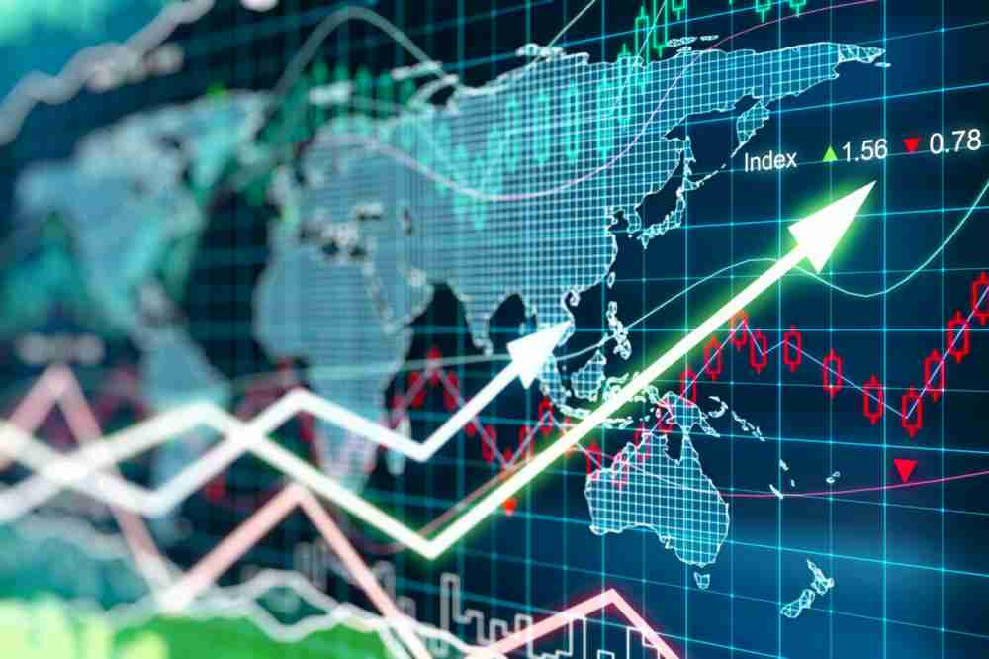
DATA VISUALIZATION PROJECT
GLOBAL SENTIMENTAL ANALYSIS AFFECTING STOCK PRICES
Notes:
Global sentiment analysis of publicly traded companies
Sentiment Analysis: An approach to trading stocks globally

Slide 2
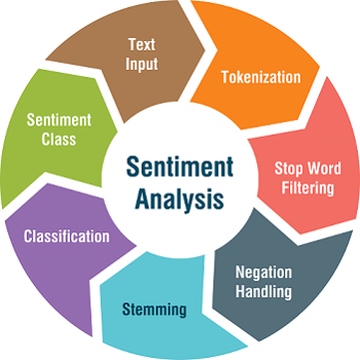
Problem Statement
Predicting the direction of the stock market is a well-known problem of interest. Sentiment pulled from social media is a viable proxy for aggregate market sentiment
In this project, we processed text data relevant to a public firm and attempt to explain that firm’s subsequent price movements
We claim to find that aggregate sentiment towards a stock will aid in predicting subsequent returns

Slide 3

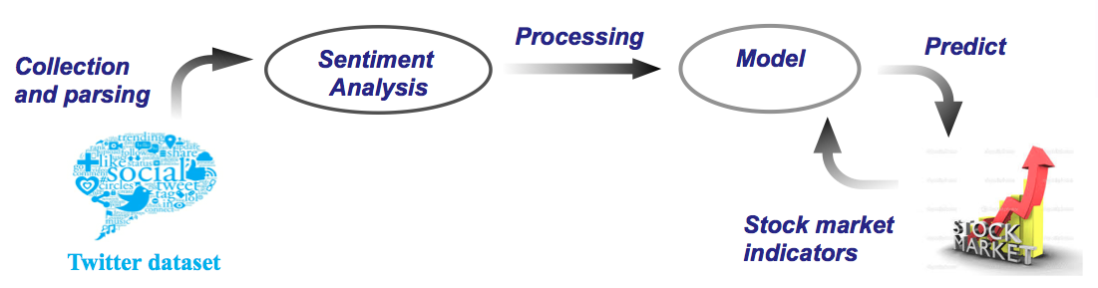
Overview
Feature Extraction
Tokenization
Lexicons
Sentiment Analysis
Prediction of Stocks by using various models and Financial Techniques.

Slide 4
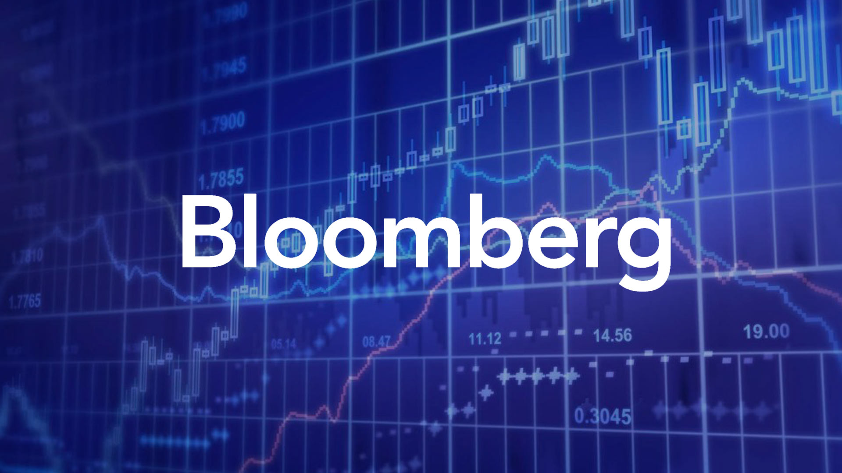
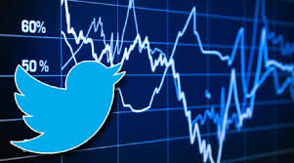
Data sources
Bloomberg - news articles
WRDS, Alpha Vantage,Quantmod, Bloomberg or Yahoo Finance- for stock returns and other financial data
Twitter API - for tweets

Slide 5
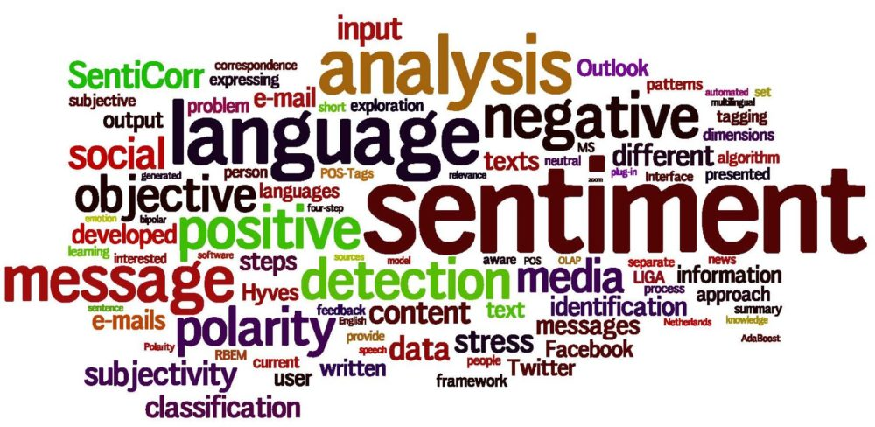
Design Decisions
Candlestick charts
Indexing chart
Superimposed line chart
Bar Charts
Sentiment word cloud

Slide 6
Research Questions
What is the relationship between mentions of a company and price movement of that company's stock?
What is the relationship between aggregate sentiment for a company and the price movement of that company's stock?
Is there a causative relationship between stock price movements and mentions/sentiment relating to a company? Which way does this relationship lead?
What is the best statistical model to predict the price of the stock based on the sentiment analysis?

Slide 7
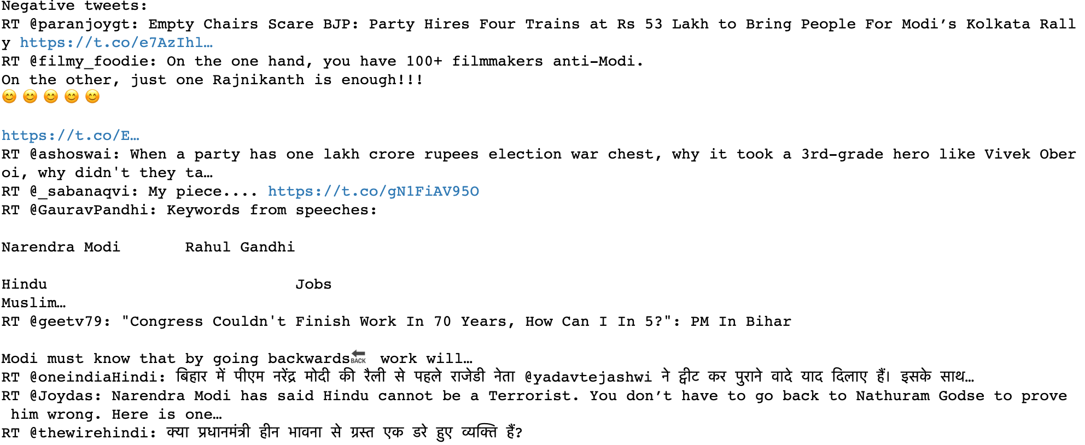
Getting the data
The script had several other additions such as the actual extraction of tweets.
The challenge - To understand which event triggered the stock prices , it was necessary to understand which tweet was tweeted during what phase or as a result of which event.
Ex. Prime minister of India during elections :

Slide 8
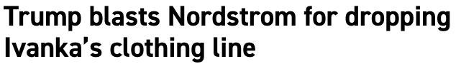
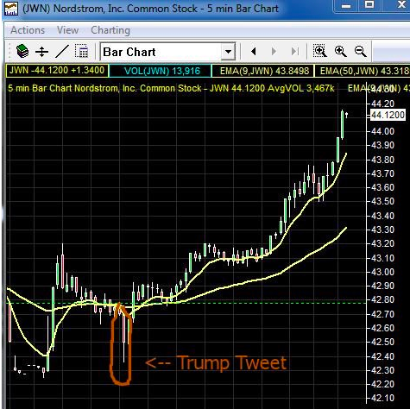
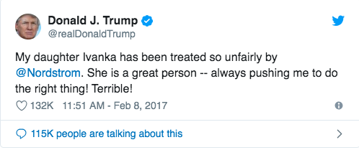
Examples of Sentiments which affects stock prices

Slide 9

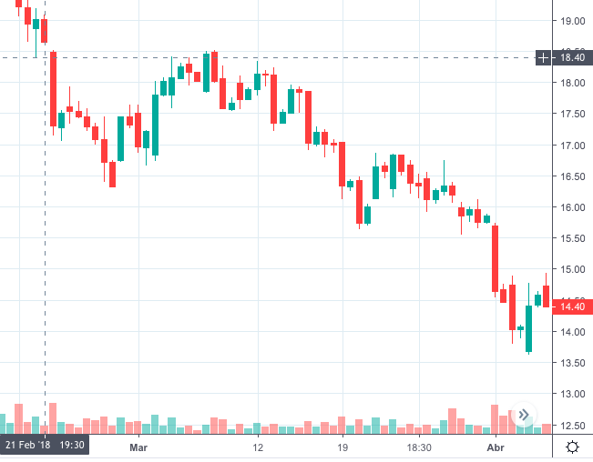


Slide 10
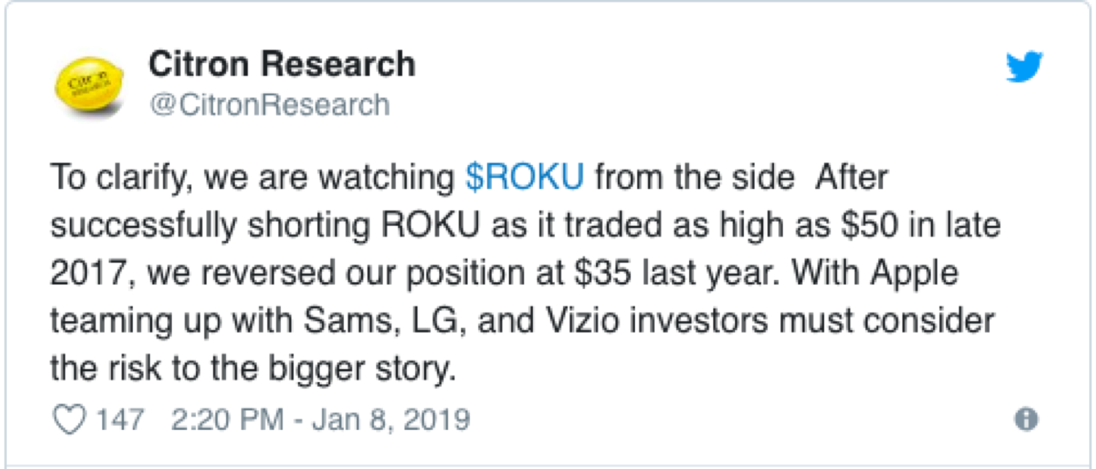
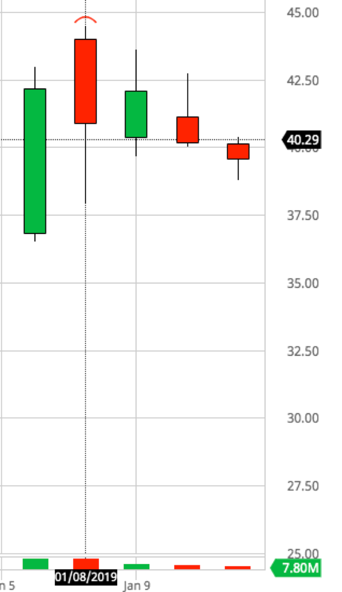
Citro calls ROKU “Uninvestible”
January 8, 2019 (Open Price): $43.98
January 8, 2019 (Closing Price): $40.88
January 8 ,2019 (Minimum Price): $37.91
Price dropped a total of 7.05% in a trading session.

Slide 11
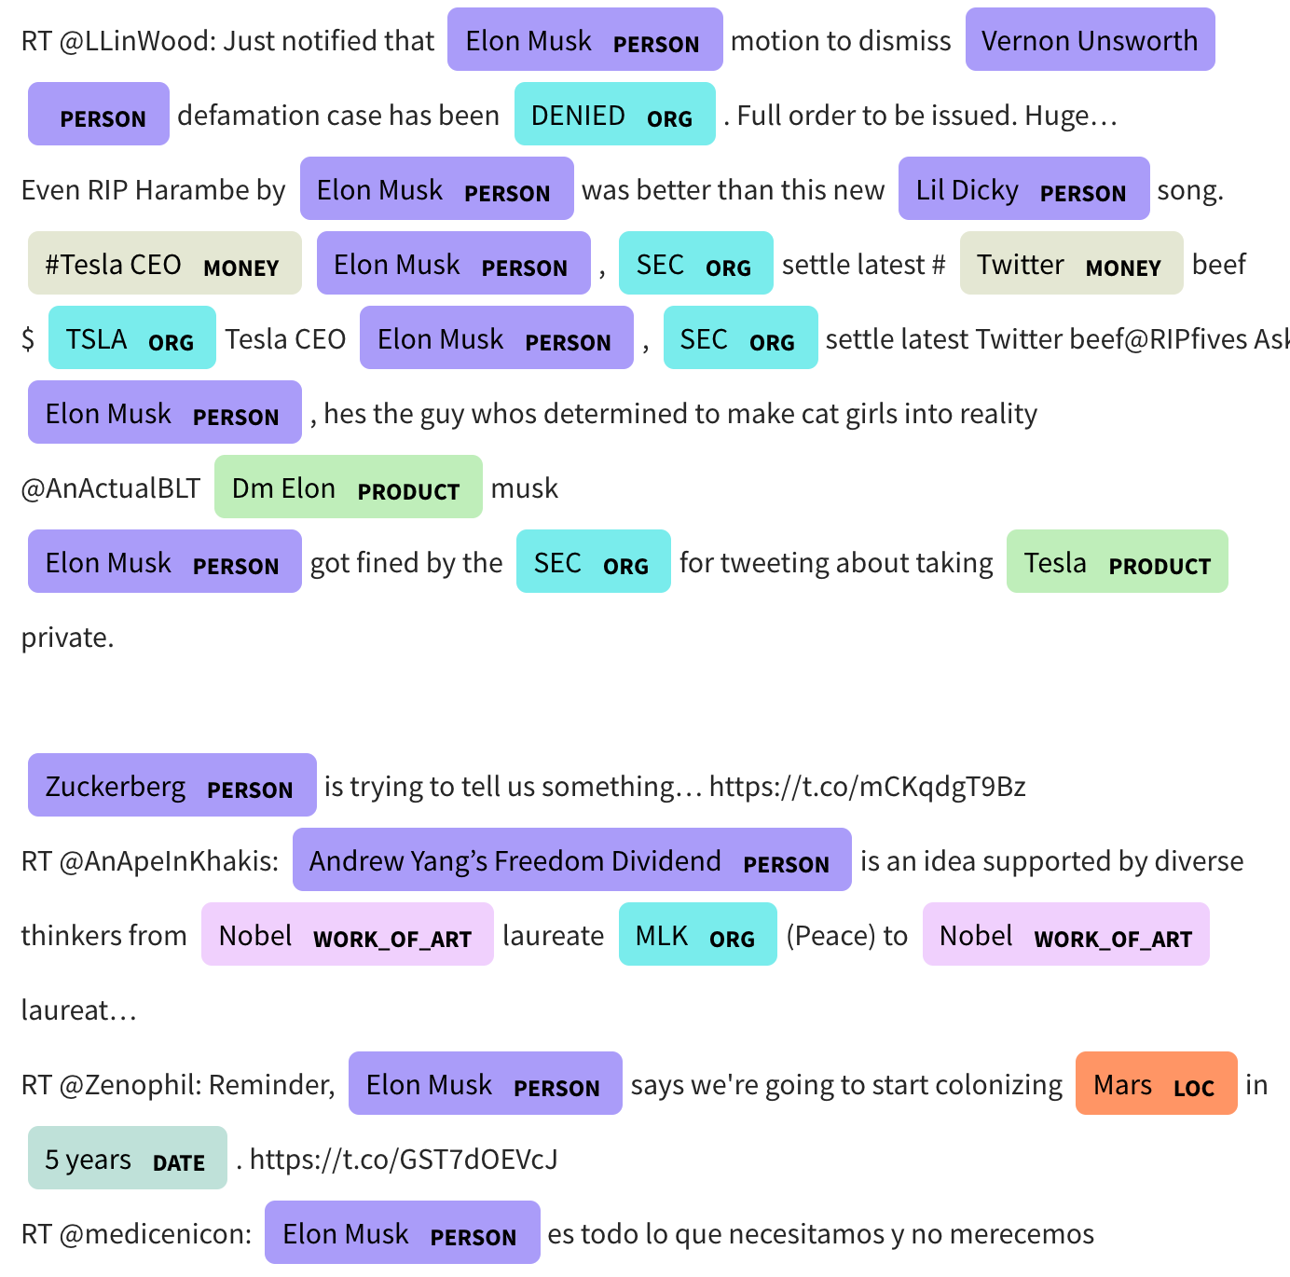
Elon Musk tweets
The image beside shows the analysis of Elon Musk’s tweets.
We have color tagged the tweets in such a way that one can understand what organizations and persons the tweet is associated to.
From this visualization the sentiment around the organization is obtained.

Slide 12
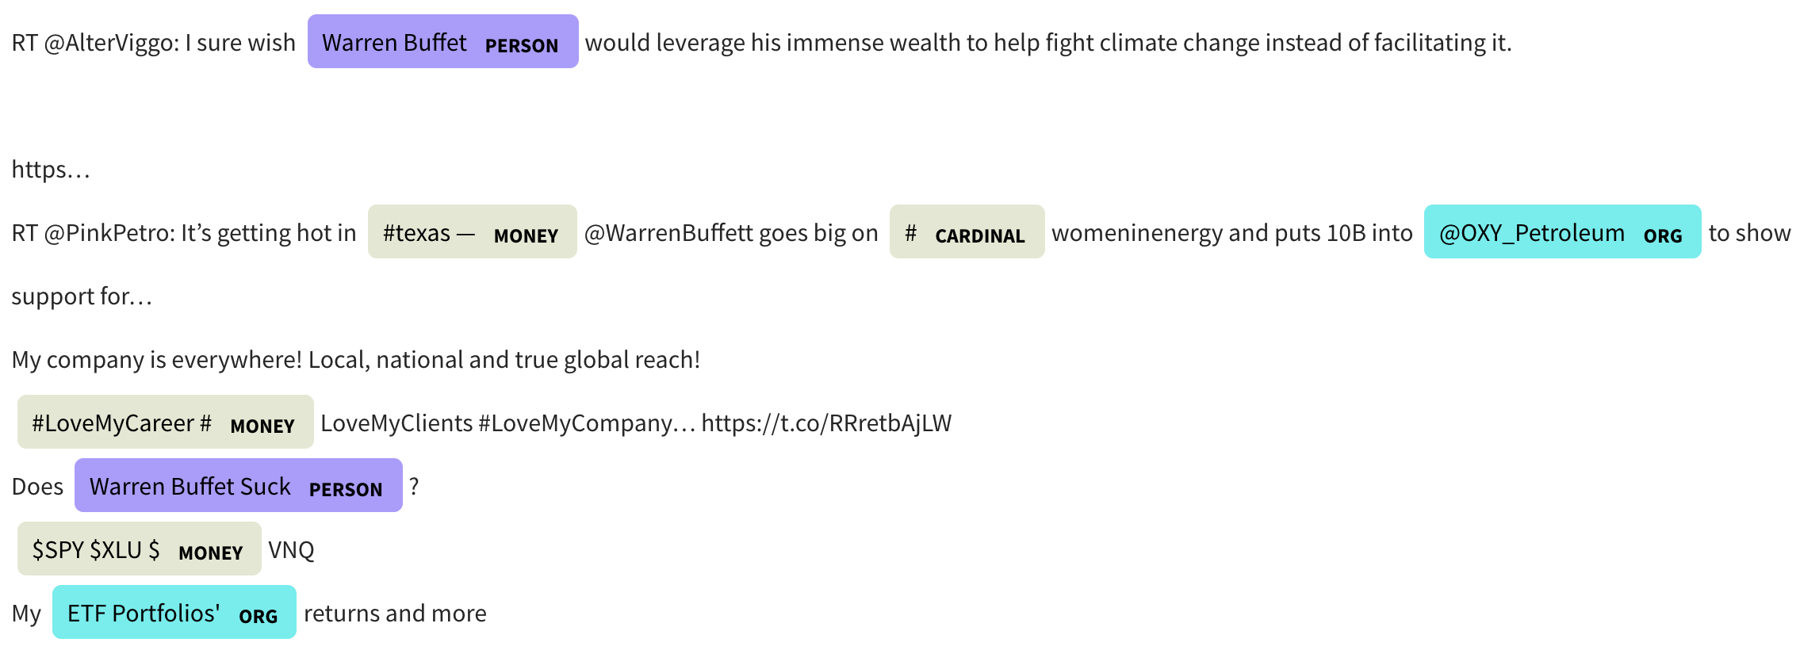
Warren Buffett tagging

Slide 13
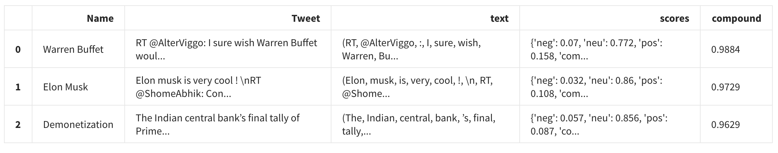
Scores of tagged results for a company

Slide 14
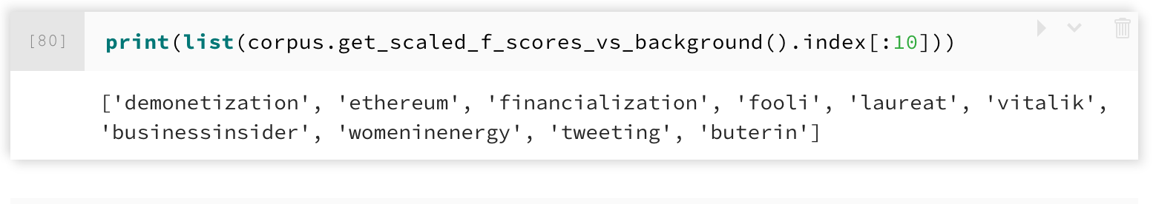
List of most important topics talked about

Slide 15
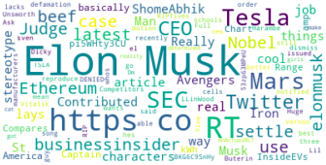
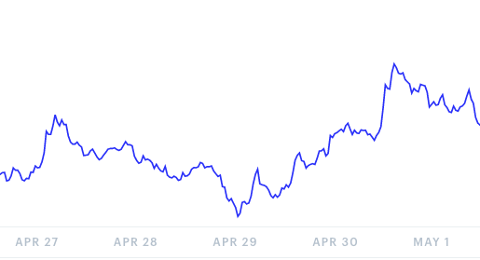
Visual Correlation between Elon Musk and ETH Price
Ethereum Chart

Slide 16
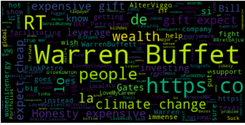
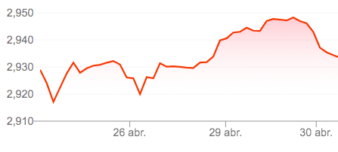
Visual Correlation between Warren Buffett and SP500
SP500 Chart

Slide 17
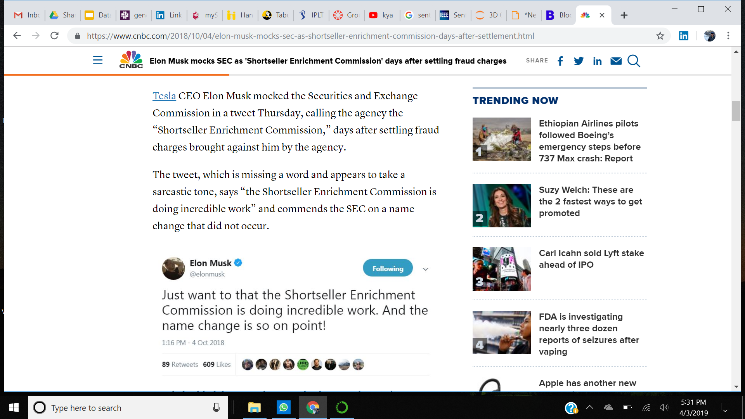
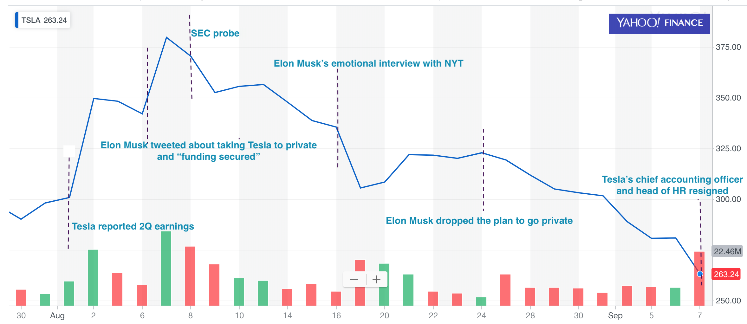
Tesla’s Stock Movement

Slide 18
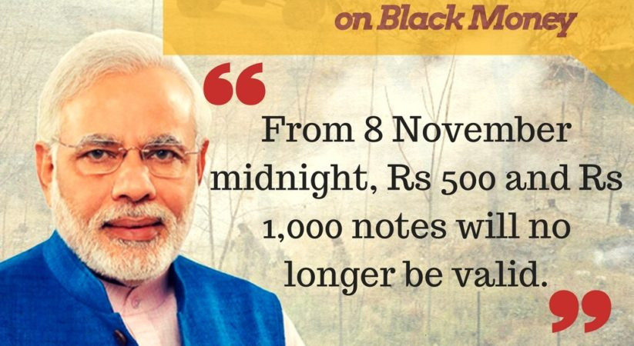
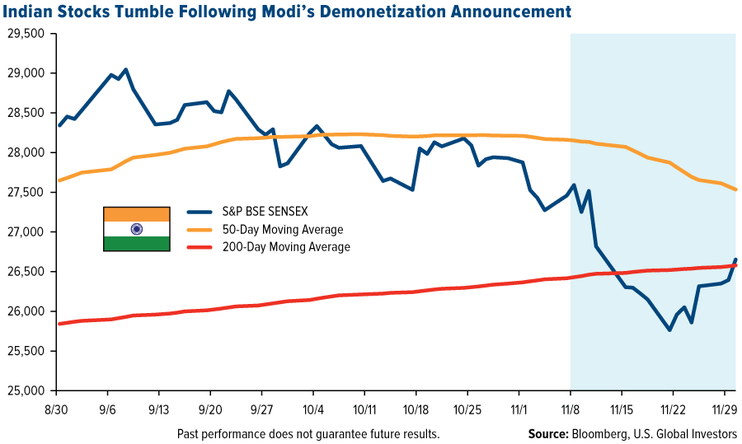
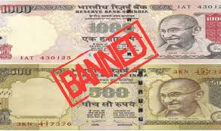
Demonetization Effect on Indian Stock Market

Slide 19
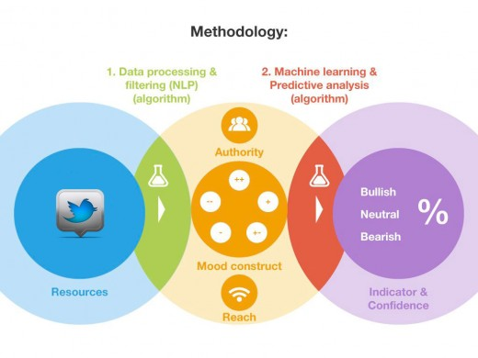
Prediction -Based on the best model
In our idea, when the return becomes very low with down direction, it is time for us to buy, and when return becomes very high with up direction, it is time for us to sell.
We pick the buy and sell boundary from the distribution of return that we gain from Lasso regression.

Slide 20
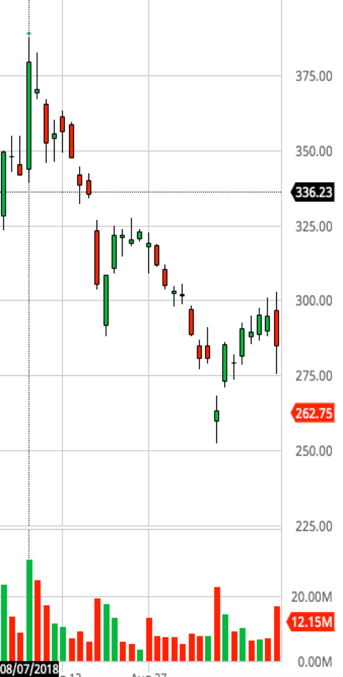
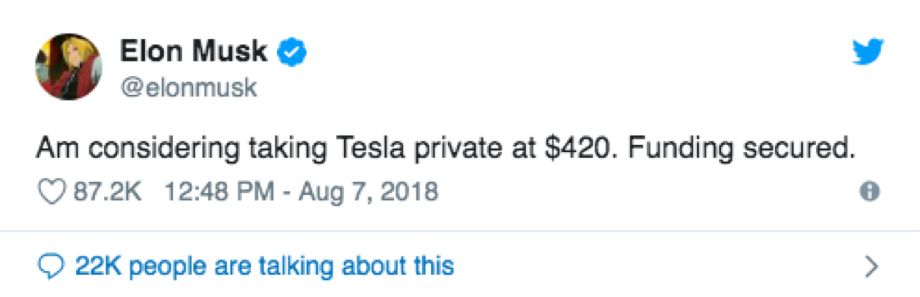
Elon Musk - Tweet on Tesla
August 7, 2018 (Open Price): 343.84
August 7, 2018 (Closing Price): 379.57
10% increase in stock in just a single trading session.

Slide 21
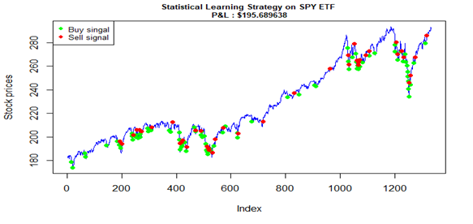
Result of Trade based on the strategy.
From the performance result, we gain $195 profit with this strategy.

Slide 22


